Slide 1
6.852: Distributed Algorithms Fall, 2015
Lecture 4

Slide 2
Last time
Shortest Paths: Distributed Bellman-Ford
Minimum Spanning Tree (MST): Gallager, Humblet, Spira.
Maximal Independent Set (MIS): Luby
Today:
Finish Luby MIS analysis
Then on to Graph Coloring (Stephan Holzer)

Slide 3
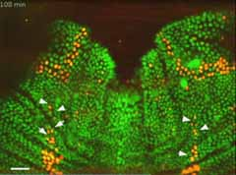
Maximal Independent Set
Notes:
The picture in the lower right is from a biology paper, in Science, which studies a maximal independent set problem that arises in the development of the fruit fly.

Slide 4
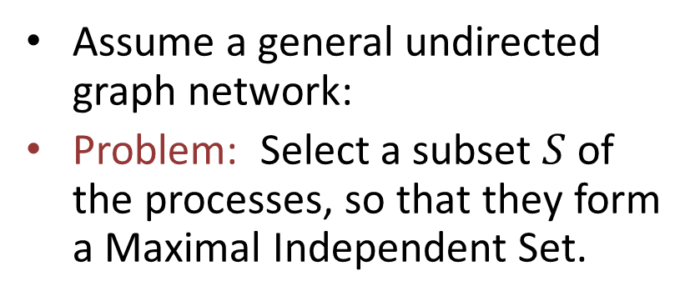
Maximal Independent Set (MIS)
Assume a general undirected graph network:
Problem: Select a subset $S$ of the processes, so that they form a Maximal Independent Set.
Independent: No two neighbors are both in the set.
Maximal: We can’t add any more nodes without violating independence.

Slide 5

Distributed MIS Problem
Assume:
No UIDs
Processes know a good upper bound on $n$.
Require:
Compute an MIS $S$ of the network graph.
Each process in $S$ should output $winner$, others output $loser.$
Notes:
A bound on the local degree would do.

Slide 6
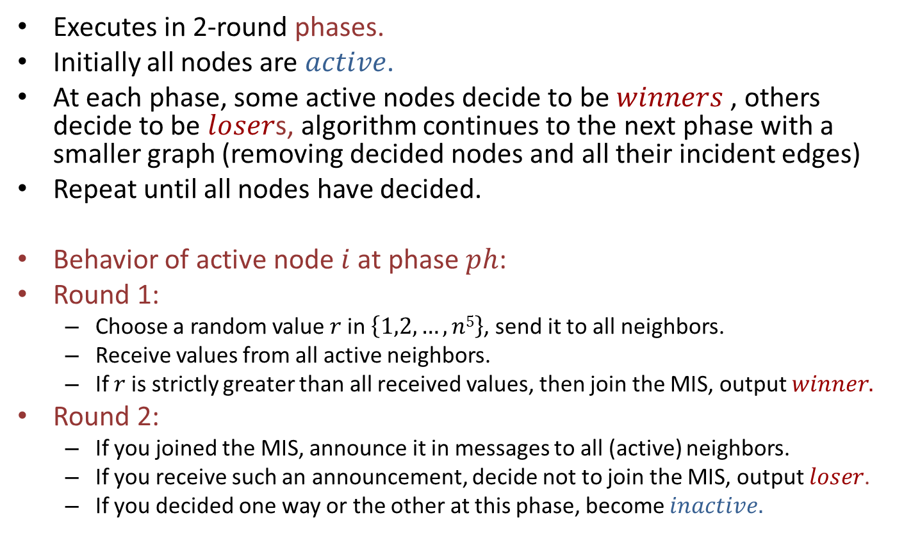
Luby’s Algorithm
Executes in 2-round phases.
Initially all nodes are $active$.
At each phase, some active nodes decide to be $winners$ , others decide to be $loser$s, algorithm continues to the next phase with a smaller graph (removing decided nodes and all their incident edges)
Repeat until all nodes have decided.
Behavior of active node $i$ at phase $ph$:
Round 1:
Choose a random value $r$in $\left\{1,2,…,n5\right\}$, send it to all neighbors.
Receive values from all active neighbors.
If $r$is strictly greater than all received values, then join the MIS, output $winner.$
Round 2:
If you joined the MIS, announce it in messages to all (active) neighbors.
If you receive such an announcement, decide not to join the MIS, output $loser$.
If you decided one way or the other at this phase, become $inactive.$
Notes:
Range is chosen to be large enough set so it’s likely that all numbers are distinct.
Round 1:
Sending to all neighbors means sending on all outgoing ports. The node is not really sure whom the ports are connected to, since we have no UIDs.
Receiving from all active neighbors just means to receive whatever arrives at that round. These will be just the messages from the active neighbors.
I’m not having the losers announce that they are losers. The nodes don’t actually know at this point which neighbors are in and out (and they have no UIDs to use to name the neighbors anyway). But it will just happen that the graph gets reduced at the next phase, because the decided nodes will just stop participating.

Slide 7
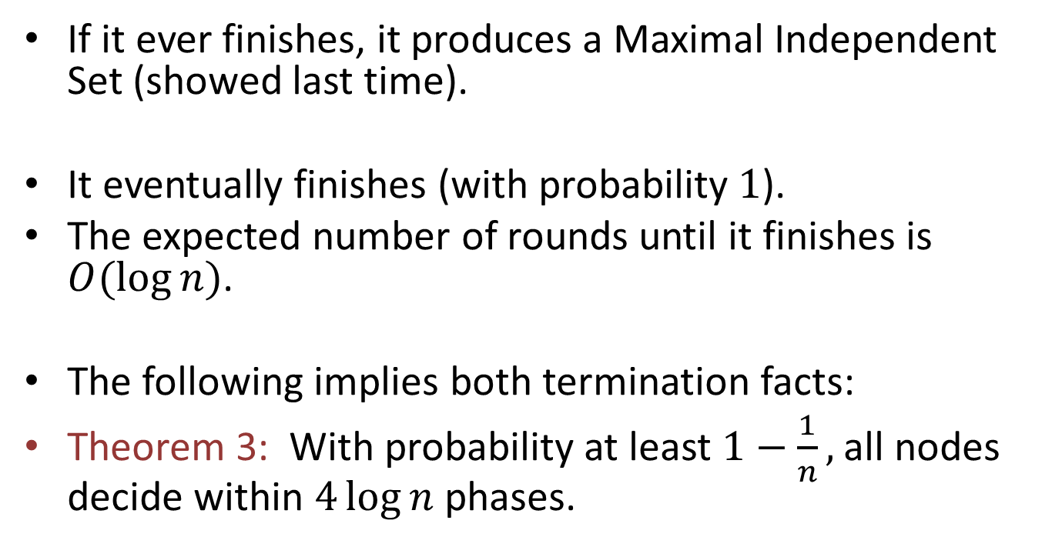
Properties
If it ever finishes, it produces a Maximal Independent Set (showed last time).
It eventually finishes (with probability $1$).
The expected number of rounds until it finishes is $O(log⁡n)$.
The following implies both termination facts:
Theorem 3: With probability at least $1−\frac{1}{n},$ all nodes decide within $4\log{n }$phases.
Notes:
Theorem numbering follows from last time.
Theorem 3 implies eventually finishes wp 1:
Suppose not, then it fails to finish with some positive probability epsilon. Choose n large enough so epsilon > 1/n, so w prob at least 1/n, fails to terminate at all. Contradicts Theorem 3, which implies it terminates with prob at least 1/-n.
Theorem 3 implies bound on expected number of phases (double to get a bound on expected number of rounds):
Let R = phases to termination (random var).
Let p = prob. of finishing within 4 log n phases.
Then:
E[R] \leq p (4 log n) + (1-p) (4 log n + E[R]).
This is because, in cases where the algorithm doesn’t finish within 4 log n phases, it can’t do any worse than if it started over after the 4 log n phases.
Solving for E[R] yields E[R] \leq 8 log n, (assuming n \geq 2).

Slide 8
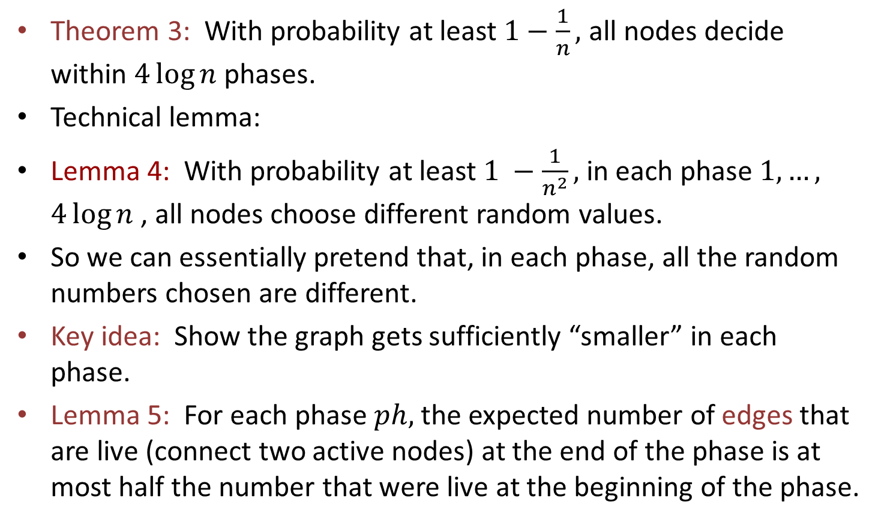
Termination
Theorem 3: With probability at least $1−\frac{1}{n},$ all nodes decide within $4\log{n }$phases.
Technical lemma:
Lemma 4: With probability at least $1 −\frac{1}{n^{2}},$ in each phase $1,…,$ $4\log{n }$, all nodes choose different random values.
So we can essentially pretend that, in each phase, all the random numbers chosen are different.
Key idea: Show the graph gets sufficiently “smaller” in each phase.
Lemma 5: For each phase $ph,$ the expected number of edges that are live (connect two active nodes) at the end of the phase is at most half the number that were live at the beginning of the phase.
Notes:
The expected number of rounds until termination is $O(log n).$
We prove something stronger, a high-probability bound.
This implies eventual termination with prob 1.
With probability 1, Luby’s MIS algorithm eventually terminates.
We show this by showing Theorem 3---the probability that they decide gets higher and higher, approaching 1, as we execute more and more phases.
We can pretend they are distinct. The exceptional case can be handled at the end using a union bound.
Lemma 5 is conditioning on a particular execution through the previous phases, leading to a particular graph of active nodes and live edges.

Slide 9
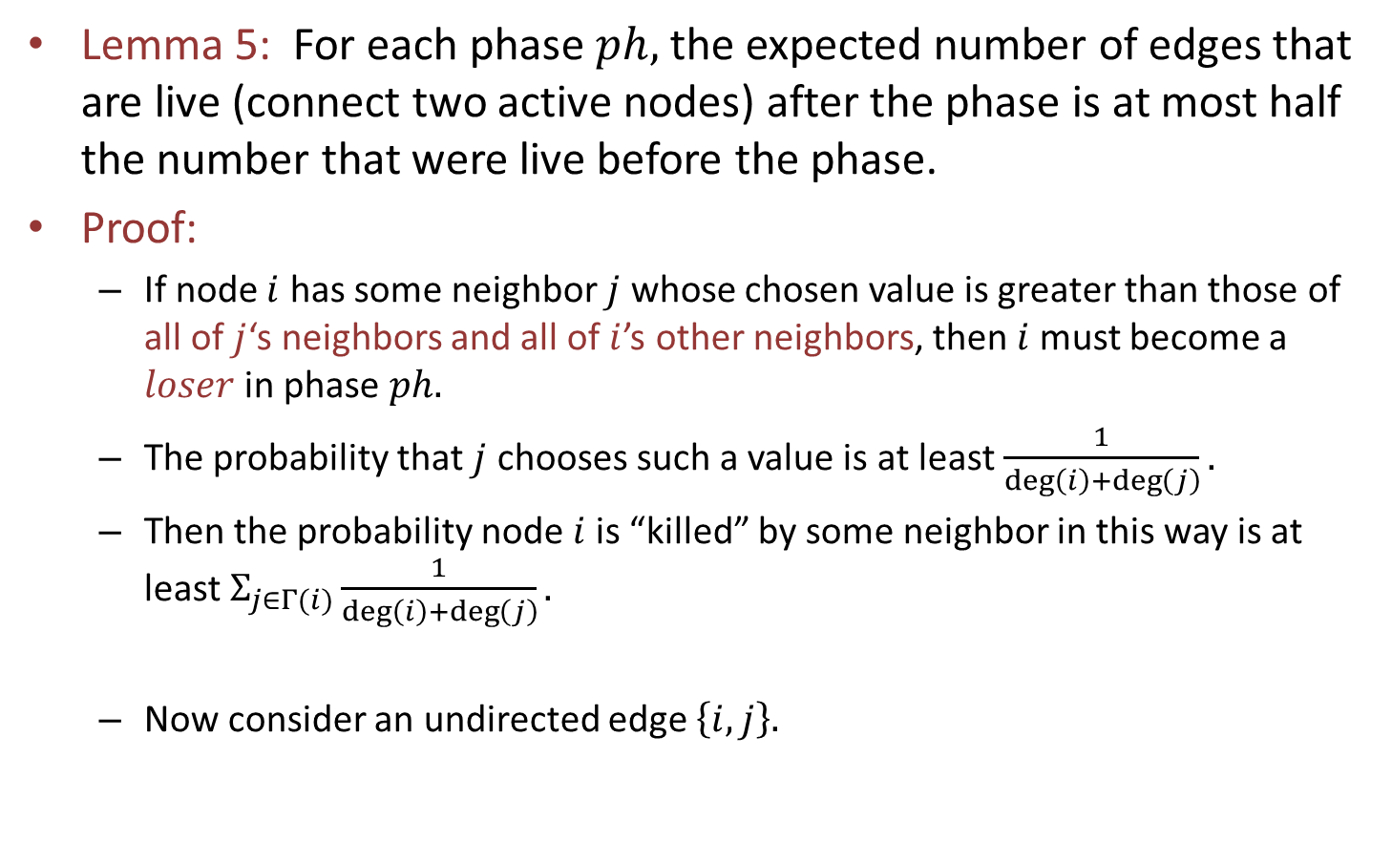


Termination
Lemma 5: For each phase $ph,$ the expected number of edges that are live (connect two active nodes) after the phase is at most half the number that were live before the phase.
Proof:
If node $i$ has some neighbor $j$ whose chosen value is greater than those of all of $j$‘s neighbors and all of $i$’s other neighbors, then $i$must become a $loser$ in phase $ph.$
The probability that $j$ chooses such a value is at least $\frac{1}{\deg\left(i\right)+\deg\left(j\right)}.$
Then the probability node $i$is “killed” by some neighbor in this way is at least $Σ_{j∈Γ(i)}\frac{1}{\deg\left(i\right)+\deg\left(j\right)}.$
Now consider an undirected edge $\left\{i,j\right\}.$
$$i$$
$$j$$
Notes:
This is based on a new proof by Yves Metivier et al.
Yesterday we discovered an earlier paper with the same type of proof---by Aaron Windsor. Still have to read it…
This is a sufficient condition for deciding out. It’s somewhat pessimistic, but it works to give the needed bound.
This bound for j uses the fact that each of i and j is in the other’s neighbor set.
The summation is over the neighbors of i.
The reason that we can add is that the different terms refer to disjoint events: if one neighbor “kills” i than another one cannot.
Here I’m using the Gamma as an abbreviation for “nbrs”.
But we are trying to prove that a lot of edges die, not just nodes. So…

Slide 10
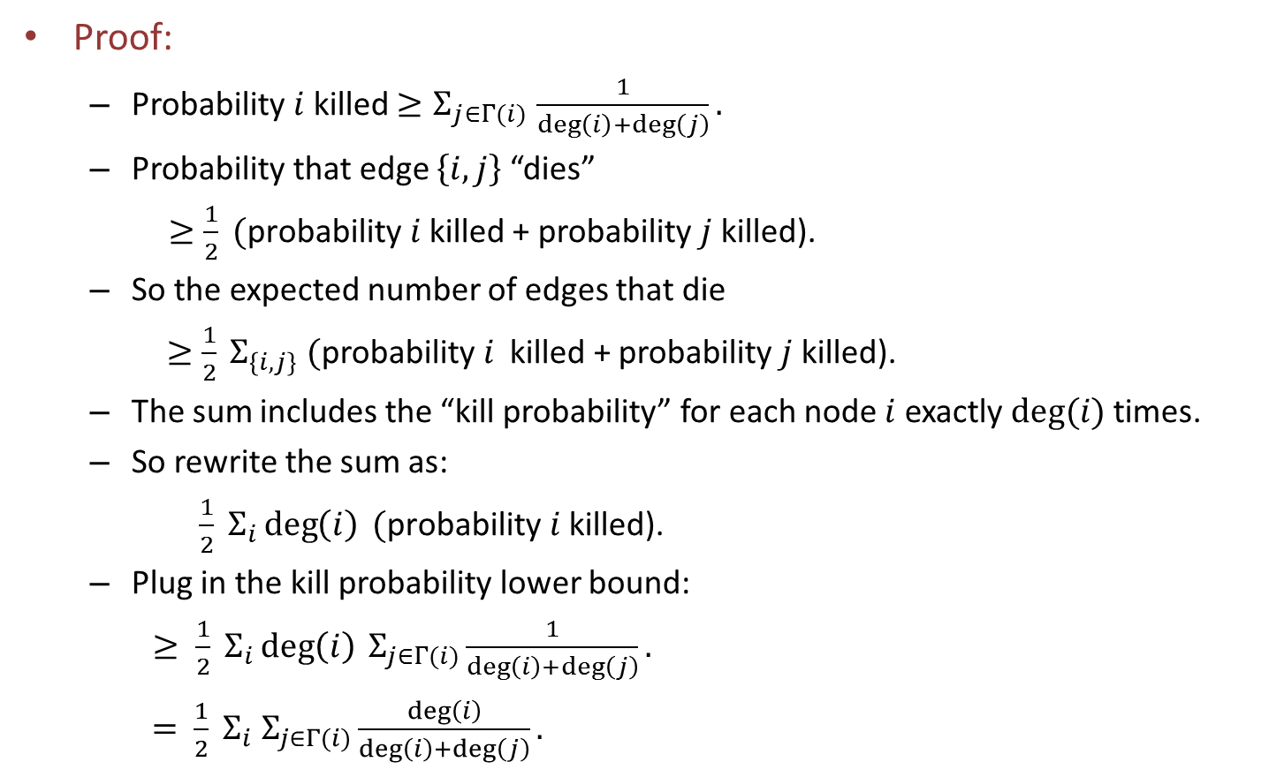
Termination, cont’d
Proof:
Probability $i$ killed ${≥Σ}_{j∈Γ(i)}\frac{1}{\deg\left(i\right)+\deg\left(j\right)}.$
Probability that edge $\left\{i,j\right\}$ “dies”
$≥\frac{1}{2} (\text{probability} i$killed + probability $j$ killed).
So the expected number of edges that die
$≥\frac{1}{2} Σ_{\left\{i,j\right\}} (\text{probability} i$ killed + probability $j$ killed).
The sum includes the “kill probability” for each node $i$ exactly $deg⁡(i)$ times.
So rewrite the sum as:
$\frac{1}{2} Σ_{i}\deg\left(i\right) (\text{probability} i \text{killed}\text{)}\text{.}$
Plug in the kill probability lower bound:
$≥ \frac{1}{2} Σ_{i}\deg\left(i\right) Σ_{j∈Γ(i)}\frac{1}{\deg\left(i\right)+\deg\left(j\right)}.$
$= \frac{1}{2} Σ_{i} Σ_{j∈Γ(i)}\frac{\deg\left(i\right)}{\deg\left(i\right)+\deg\left(j\right)}.$
Notes:
An edge must die if one of its endpoints gets killed. Then the endpoint would get removed from the graph, so also the edge would get removed.
Work out the first inequality:
I = event that i is killed, J = event that j is killed.
P(edge killed) \geq P(I) + P(J) – P(I \cap J), which must be \geq ½ (P(I) + P(J)). Check this by a simple case analysis based on whether I \geq J or not.
Now stare at this sum…

Slide 11
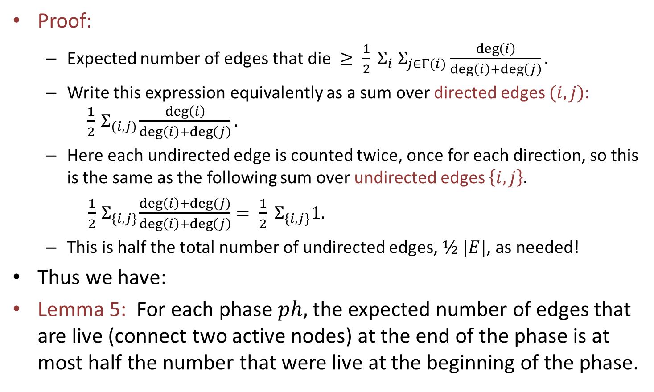
Termination, cont’d
Proof:
Expected number of edges that die $≥ \frac{1}{2} Σ_{i} Σ_{j∈Γ(i)}\frac{\deg\left(i\right)}{\deg\left(i\right)+\deg\left(j\right)}.$
Write this expression equivalently as a sum over directed edges $(i,j)$: $\frac{1}{2}{ Σ}_{(i,j)}\frac{\deg\left(i\right)}{\deg\left(i\right)+\deg\left(j\right)}.$
Here each undirected edge is counted twice, once for each direction, so this is the same as the following sum over undirected edges $\left\{i,j\right\}.$
$\frac{1}{2}{ Σ}_{\{i,j\}}\frac{\deg\left(i\right)+deg⁡(j)}{\deg\left(i\right)+\deg\left(j\right)}= \frac{1}{2}{ Σ}_{\{i,j\}}1.$
This is half the total number of undirected edges, $½ |E|$, as needed!
Thus we have:
Lemma 5: For each phase $ph,$ the expected number of edges that are live (connect two active nodes) at the end of the phase is at most half the number that were live at the beginning of the phase.
Notes:
We’re nearly done…
Recap: The expected number of edges that die is at least half of what we started with.
That is, we have proved Lemma 9: For each phase $ph,$ the expected number of edges that are live (connect two active nodes) at the end of the phase is at most $\frac{1}{2}$the number that were live at the beginning of the phase.

Slide 12
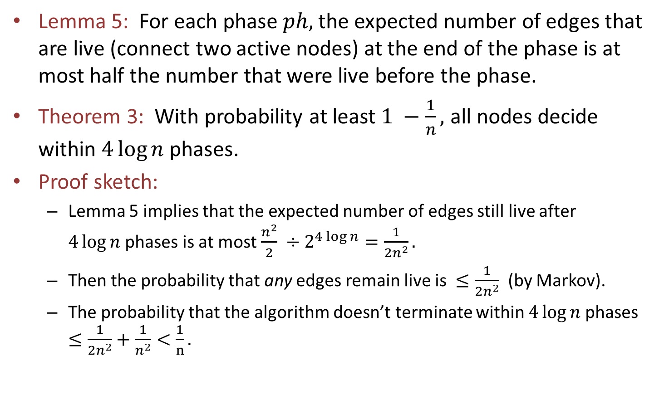
Termination, cont’d
Lemma 5: For each phase $ph,$ the expected number of edges that are live (connect two active nodes) at the end of the phase is at most half the number that were live before the phase.
Theorem 3: With probability at least $1 −\frac{1}{n},$ all nodes decide within $4\log{n }$phases.
Proof sketch:
Lemma 5 implies that the expected number of edges still live after $4\log{n }$phases is at most $\frac{n^{2}}{2}$ $÷2^{4\log{n}}=\frac{1}{{2n}^{2}}.$
Then the probability that any edges remain live is $≤\frac{1}{{2n}^{2}}$ (by Markov).
The probability that the algorithm doesn’t terminate within $4\log{n }$phases $≤\frac{1}{{2n}^{2}}+\frac{1}{n^{2}}<\frac{1}{n}.$
Notes:
Now let’s tidy up.
Expectation divides by 2 at each phase using the Law of Iterated Expectation.
We get rid of all the edges, with probability at least 1 – 1/2n^2.
This is based on elementary probability, in particular, Markov’s inequality.
The next-to-last inequality takes into account both the live-edge probability and the probability we mentioned earlier, of two nodes choosing the same value at the same phase, simple union bound.

